Slide 1
Do Now: 3/21 1. Pick up a half sheet of paper 2. Flip over to back 3. Answer the following: How many feet are in 34 yards?
Objective
I can identify the systems used around the world (Metrics = SI; English = USA) I can list the prefixes and determine how many of one are needed to create another (mm in one cm)
Agenda
Brain pop Metric conversions Practice
Homework
NONE

Slide 2
Do Now: 3/21 1. Pick up a half sheet of paper 2. Flip over to back 3. Answer the following: How many feet are in 34 yards?
Objective
I can describe Motion by comparing the position of one object as it relates to another object (point of reference) I can calculate/demonstrate speed through measuring my distance traveled over a unit of time
Agenda
Brain pop Metric conversions Practice
Homework
NONE

Slide 3
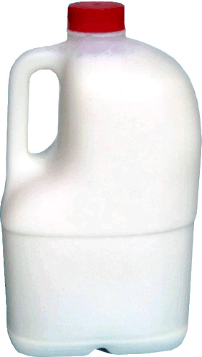
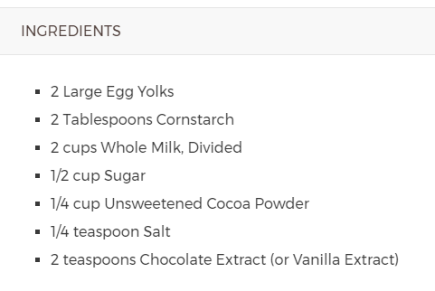
USA vs. World
Do you have enough milk?
Volume = Liters, fluid ounces
Volume = gallons, quarts, cups

Slide 5
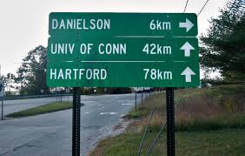
Can you go the distance?
How far is Hartford?
Distance = meters

Slide 6
How much?
3.5 kg
63.5 kg
7.7 lbs
140 lbs
Mass = grams (g)

Slide 7
How to change?
Change is called CONVERSION.
Where are you starting?
Gallons
Where are you going?
Gallons to Liters
What do you need to do?
Gallons to Liters multiply by 3. 785
1 Gallon
x 3.785
= 3.785 Liters

Slide 8
How to change?
Distance CONVERSION.
Where are you starting?
Miles
Where are you going?
Miles to Kilometers
What do you need to do?
Miles to Km multiply by 1.609
1 Mile
x 1.609
= 1.609 km

Slide 9
How to change?
Mass CONVERSION.
Where are you starting?
Pounds
Where are you going?
Pounds to Grams
What do you need to do?
Pounds to gr
multiply by 1.609
1 Mile
x 1.609
= 1.609 km

Slide 10
English & Metric Conversions

Slide 13
MOTION
What is motion? How can you describe the motion of different objects? What does all motion have in common?
As each object is shown, think about how you would describe its motion.
Try to be thinking of a definition for motion that would fit all the different items!

Slide 14
How is it moving?
A
D
B
C
E
F
G
H
I

Slide 15
So…what is motion?

Slide 16
So…what is motion?
Motion is a change in position over time!!

Slide 17
So…what is motion?
Distance
If you change your position, then you have traveled some distance.

Slide 18
So…what is motion?
Distance
How fast you travel that distance is your speed! (Speed is the RATE at which you change position).

Slide 19
Distance
Length
Amount of space between two given points
Does unit matter?

Slide 20
How can we describe motion?
Motion can be described by:
DISTANCE
(how far did it travel?)
TIME
(how long did it travel?)
SPEED
(how fast did it travel?)
DIRECTION
(which way did it go?)
ACCELERATION
(does the motion change?)

Slide 21
Metric System (remember?)
Why metric? US vs. World; accuracy; ease
Based on 10s…not 12 or 3 or whatever
Kilo, Hecto, Deka
deci, centi, milli
PRE-fixes

Slide 22
Draw out the metric stair-step…
L
R
1. Kilo
2. Hecto
3. Deka
4. UNIT
5. deci
Meters = length or distance
Liters = volume
Grams = mass or weight
6. centi
7. milli

Slide 23
In math terms…
A “change in position over time” is the same as saying:
Distance
Speed =
Time

Slide 24
Practice these together
1.) 103 km = __________ dm
2.) 00.996 hm = __________ km
3.) 65.8 mm = _______ cm

Slide 25
Practice these on your own (show the decimal movement)
1.) 10 Dkm = ________ dm
2.) 2.94 Hm = ________ cm
3.) 51.73 m = ________ km
4.) 0.232 km = _______ m
5.) 00.0318 km = _________ mm
6.) 0.422 Dkm = __________ mm
7.) 98 dm = ________ Dkm
8.) 325 mm = __________ cm

Slide 26
What does “speed” mean?
Some examples of speed:
60 miles/hour 100 meters/minute
Let’s break it down…
If you travel 60 miles per hour, how far do you travel in 1 hour?
60 miles/hour is the same as 60 miles
1 hour

Slide 27
Let’s practice calculating speed
If you travel 100 km in 2 hours, what is your speed?
Speed = Distance
Time
Distance = 100 km Time = 2 hours
Speed = 100 km
2 h
Speed = 50 km/h

Slide 28
Speed, Distance & Time
Speed = Distance
Time
Time = Distance
Speed
Distance = Speed x Time
D
S
T

Slide 29
Speed Practice Problems
A family takes a car trip heading northeast from Durham, NC to Washington, DC. They travel for 4 hours and cover 360 km.
What was their average speed?
Speed = Distance
Time
= 360 km
4 h
= 90 km/h

