Slide 1
Integer Operations X and ÷

Slide 2
Warm-up 9/19/16
Copy and Solve Each Problem below:
2.)

Slide 3
What strategies can I use to multiply rational numbers?

Slide 4
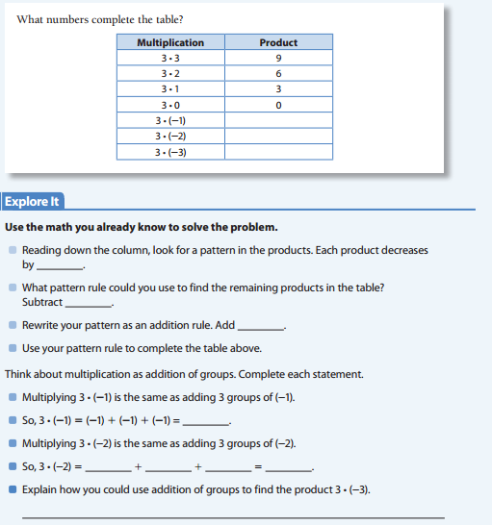

Slide 5
15 Minute Math – Decimals Lesson # 3 – Multiplication
Try it yourself
27.2 × 9.2 = 3.2904 × 0.22 = 62.5 × 12.8 =
38 × 0.25 = 0.034 × 0.026 = 8.02 × 2.1 =
2.04 × 0.001 = 589 × 100 = 10.2 × 1.2 =
0.34 × 0.5 = 5.89 × 100 = 9.9999 × 0.01 =
Click for answers:
27.2 × 9.2 = 250.24 3.2904 × 0.22 = 0.723888 62.5 × 12.8 = 800
38 × 0.25 = 9.5 0.034 × 0.026 = 0.000884 8.02 × 2.1 = 16.842
2.04 × 0.001 = 0.00204 589 × 100 = 58,900 10.2 × 1.2 = 12.24
0.34 × 0.5 = 0.17 5.89 × 100 = 589 9.9999 × 0.01 = 0.099999
End of Lesson 3

Slide 6
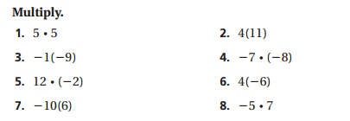
Video https://www.youtube.com/watch?v=QmarTb7wXro
Solve each Problem:
Summary: The video talked about algorithms for multiplying integers. What is this algorithm?

Slide 7
LA #2-I can multiply decimals.
I do:
Example problem:
Problem: You need to buy 12 cans of paint costing $5.29 each. How much will you pay?
5.29 (2 digits to the right of the decimal)
× 12 (0 digits to the right of the decimal.
63.48 (2 digits to the right of the decimal)
Steps: When multiplying numbers with decimal points, count the total number of numbers to the right of the decimal point in the problem and make sure the answer has the same number!

Slide 8
We do together: Find -2.5 x 3.6

Slide 9
Try it yourself:
2.04 × 0.001 =____
589 × 100 =____
10.2 × 1.2 =____
0.34 × 0.5 = ____
5.89 × 100 = ____
9.9999 × 0.01 =___

Slide 10
Summarizer
Complete the sentence: Steps to multiplying decimals are like _______________.

Slide 11
I can Multiply Fractions.

Slide 12
We do it together

Slide 13
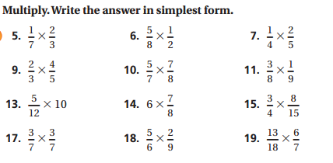
You Try IT!

Slide 14
SUMMARIZER Turn and talk to your partner about how to multiplying two fractions.

Slide 15
Summarizer Write 2 strategies you have learned for multiplying Rational numbers.

Slide 16
What strategies can I use to divide rational numbers?

Slide 17
Activator- Let’s Get thinking!
Remind me of the rules for Multiplying Integers.
Division and multiplication are

Slide 18
Video https://www.youtube.com/watch?v=Fre5g65sj0w
I do:

Slide 19
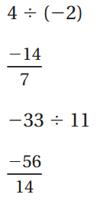
Let’s DO it together!

Slide 20
You try it!

Slide 21
Summarizer
How is the algorithm for division similar to the algorithm of multiplication?

Slide 22
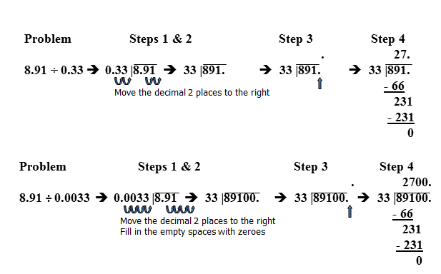
I can Divide decimals

Slide 23
We do: 1.) 3.2 ÷ 6.4 2.) 60.8 ÷ 0.19
You Do:
3.) 32.64 ÷ 6.4 4.)0.608 ÷ 0.19

Slide 24
How can you check to make sure your quotient is correct for dividing decimals?
Summarizer

Slide 25
I can Divide Fractions
Tell me what you already know about Fractions
Dividing Fractions

Slide 26
RECIPROCAL
What does this term mean?

Slide 29
We DO Together:

Slide 30
You Try it now.

Slide 31
Summarizer
What is the relationship between multiplying and dividing fractions?

Slide 32
Write 2 strategies you have learned for Dividing Rational numbers.
Lesson Summarizer

