Slide 1
Circles and 2-D Shapes
Write down what you know about circles. Draw a picture.

Slide 2
Sir Cumference
https://www.youtube.com/watch?v=4ZJU3-JXGBo
(14 min)

Slide 3
Parts of a Circle
https://www.youtube.com/watch?v=X9yfR_I8LQM
(8 min)
https://www.youtube.com/watch?v=2bQTK_85Ni4
(2 min)

Slide 4
Video Review
Based on what you saw on the videos, draw and label a circle.

Slide 5
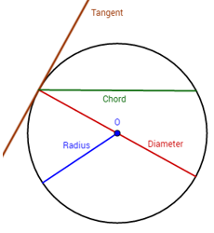
Parts of a Circle
Radius- A line from the edge of a circle to the center of the circle.
Diameter- A line that stretches across the circle that passes through the middle
Chord- a line that crosses the circle and does not pass through the center

Slide 6
Finding Radius and Diameter Using Pi
Radius is half of the diameter!
2r=d
Pi looks like this ∏ and it is approximately 3.14 or 22/7 as a fraction.

Slide 7
Circumference
The perimeter of a circle
Formula:$C=πd$ or $C=2rπ$
D=diameter r= radius

Slide 8
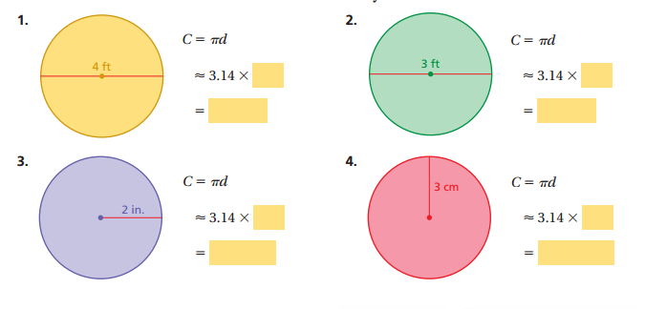
Practice

Slide 9
When do I use Circumference?
What does circumference tell me?
Name some times when I would need to find the circumference.

Slide 10
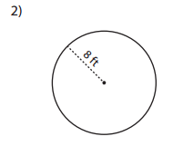
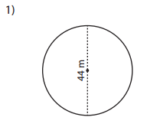
Summarizer
How can you use circumference to find the radius?
How can you use circumference to find the diameter?

Slide 11
Area of Circles
https://www.youtube.com/watch?v=YokKp3pwVFc
Formula: A= πr²

Slide 12
Practice
Find the area of a circle with a:
Radius = 10m A=_______________
Radius = 30 cm A=_______________
Diameter = 6in A=______________

Slide 13
When do I use Area of a circle?
What does area tell me?
Name some times when I would need to find the area of a circle.

Slide 14
Summarizer

Slide 15
Semi Circle
https://www.youtube.com/watch?v=7DgaPpQtAEg
What part of a circle is a semi-circle?
How is finding the area of a semi-circle different from finding the area of an entire circle?

Slide 16
Practice

Slide 17
Summarizer
How can we write the formula for a semi circle?
Solve-John is painting a sign of a rising sun, which happens to be exactly half of a circle. The half-circle's base is 30 inches long. He'll need to buy enough paint to cover how much space? (Approximate pi to 3.14)

Slide 18
Area formulas
Square/rectangle= lw
(length times width)
Triangle= ½bh
(one half time base times height)
Parallelogram=bh
(base times height)
Trapezoid= ½(b1-b2)h
(one half the top minus the bottom times height)
How does the area of a quadrilateral relate to the area of a triangle?

Slide 19
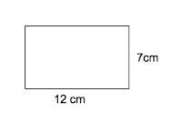
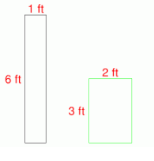
Practice-rectangle/square

Slide 20
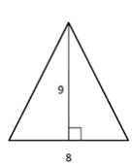
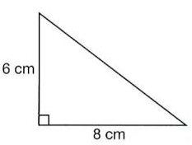
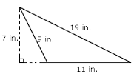
Practice-triangles

Slide 21
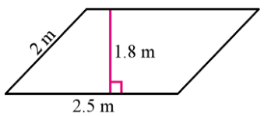
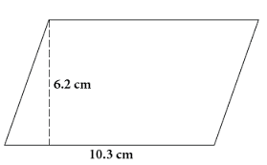
Practice- parallelograms

Slide 22
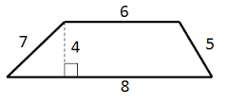
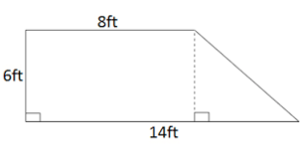
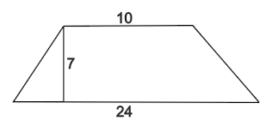
Practice- trapezoid

Slide 23
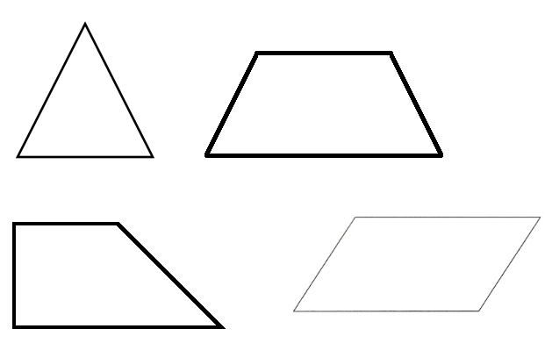
Summarizer
Match the shape to the formula you need to use.

Slide 24
Find the Area of Complex Figures
First, separate the shape into pieces you know
Second, label all the dimensions you need
Third find the area of the shapes
Fourth, add the areas

Slide 25
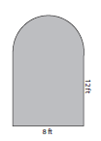
Find the Area of Complex Figures
First, separate the shape into pieces you know
Second, label all the dimensions you need
Third find the area of the shapes
Fourth, add the areas
What shapes are found in the figure?
Shape 1 is ______________
To find the area I must _______________________
Shape 2 is _____________
To find the area I must _______________________

Slide 26
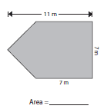
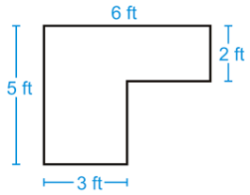
Practice
What shapes are found in the figure?
Shape 1 is ______________
To find the area I must _______________________
Shape 2 is _____________
To find the area I must _______________________
What shapes are found in the figure?
Shape 1 is ______________
To find the area I must _______________________
Shape 2 is _____________
To find the area I must _______________________

Slide 27
Practice
What shapes are found in the figure?
Shape 1 is ______________
To find the area I must _______________________
Shape 2 is _____________
To find the area I must _______________________

Slide 28
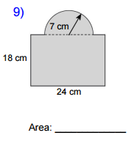
Practice
What shapes are found in the figure?
Shape 1 is ______________
To find the area I must _______________________
Shape 2 is _____________
To find the area I must _______________________

Slide 29
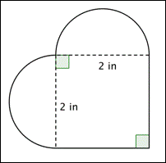
Practice
What shapes are found in the figure?
Shape 1 is ______________
To find the area I must _______________________
Shape 2 is _____________
To find the area I must _______________________
Shape 3 is _____________
To find the area I must _______________________

Slide 30
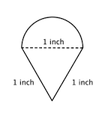
Practice
What shapes are found in the figure?
Shape 1 is ______________
To find the area I must _______________________
Shape 2 is _____________
To find the area I must _______________________

Slide 31
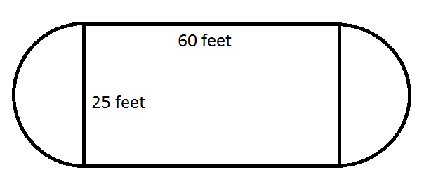
Summarizer-Solve
What shapes are found in the figure?
Shape 1 is ______________
To find the area I must _______________________
Shape 2 is _____________
To find the area I must _______________________
Shape 3 is _____________
To find the area I must _______________________

Slide 32
Circles Lesson Summarizer
3 main points (or 3 “somethings”) about circles
2 ways to find area
1 way parts of a circle are used to find circumference and area of a circle and complex shapes?

