Slide 1
Do Now:
1. Log on to the computer
2. Go to Join.quizizz.com
3. Enter the code: 485181
4. Enter your first and last name

Slide 2
Do Now: 3/29
1. Take out a piece of paper
2. Copy the following chart for 4 group members (chart below shows 1 group member)
Homework
NONE
Agenda
King or Queen Speed lab Practice
Objective
I can describe Motion and calculate speed.
Distance= Group Members | Normal Walk | Speed Walk | Skip
1. | Time (s)= Speed= | Time (s)= Speed= | Time (s)= Speed=

Slide 3
Procedures:
LISTEN TO ALL INSTRUCTIONS GIVEN TO YOU BY MRS SANFORD!
Once outside, measure the distance of one bus parking space
Each person in your group will need to speed walk, normal walk, and skip this measured distance while being timed.
  This is NOT a competition. Just a fun science activity. Any wagering, bets, or erratic behavior will not be accepted.
Record the time
Calculate your speed remember speed =d/t
Record all your data in your data table.
☺ Happy motioning!

Slide 4
Conclusion Questions
Who normal walked the fastest? Slowest? How do you know?
Who speed walked the fastest? Slowest? How do you know?
Who skipped the fastest? Slowest? How do you know?

Slide 5
Do Now: 3/30
1. Share a half sheet of paper with your neighbor
2. Write your name at the top
3. Number 1-5
Homework
None
Agenda
King or Queen Review motion/speed 4 corners game
Objective
I can describe Motion using a reference point I can calculate speed

Slide 6

King or Queen

Slide 7
What is the equation for speed?

Slide 8
Draw the magic triangle of magic for calculating speed

Slide 9
A person runs 100 meters in 10sec
What is their speed?

Slide 10
A cyclist cycles at a speed of 4km/hr for 3 hours. What distance did the cyclist travel?

Slide 11
What is motion?

Slide 12
Speed=d/t

Slide 13
10 m/s

Slide 14
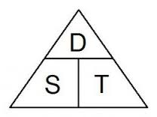
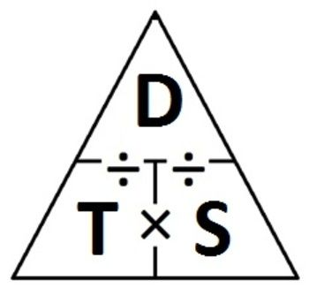

Slide 15
12km

Slide 16
Motion-
* physical movement
*Change in position or place
*Change relative to reference point

Slide 17
King or Queen

Slide 18
A cyclist cycles at a speed of 4km/hr for 3 hours. What distance did the cyclist travel?

Slide 19
What does the T stand for in the equation s=d/t

Slide 20
A person runs 100 meters in 10sec
What is their speed?

Slide 21
A car travels 100km at a speed of 20km/hr. How long did it take the car to reach its destination?

Slide 22
What is a reference point?

Slide 23
12 km

Slide 24
Time

Slide 25
10m/s

Slide 26
5 hours

Slide 27
*distance of an object from another
*A reference point is a point that is considered stationary to which the object in motion can be related to.
*Starting line

Slide 28
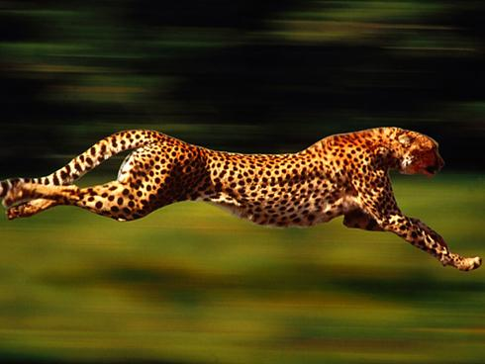
Motion

Slide 29

What is Motion?
any physical movement or change in position or place, relative to a reference point
Movement
Reference Point

Slide 30
Distance = how far an object has moved.
Measured in meters, kilometers (cm or mm)
If each mark represents 10 cm, what is the distance between the girl and the ball? ______
Y Axis
X Axis

Slide 31
Speed = the distance an object travels per unit of time (sec, hour, year..etc)
Speed Equation
Speed (meters/second) = distance (in meters)
time (sec)
s = d
t

Slide 32
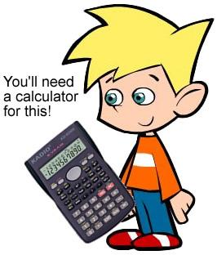
More practice. (Speed = distance/ time)
An elevator travels from the first floor to the 25th floor of a building, a distance of 180 meters, in 60 seconds. What is the elevator's speed?
Find the Distance = ______
Find the Time = _______
Calculate the Speed = _______

Slide 33

Team of 4

Slide 34
What is motion

Slide 35
What is a reference point?

Slide 36
What does the “d” stand for in the equation s=d/t

Slide 37
Using words describe speed?

Slide 38
John took 15 minutes to bicycle to his grandmother’s house, a total of 45 kilometers.
What was his speed in km/min? ______________

Slide 39
A car is traveling at 100 km/hr. How many hours will it take to cover a distance of 750 kilometers? _________________

Slide 40
A plane traveled for 2.5 hours at a speed of 1,200 km/hr. What distance did it travel?
_________________

Slide 41
A girl is pedaling her bicycle at a speed of 0.1 km/min. How far will she travel in 2 hours? _____________

Slide 42
The water in the Buffalo River flows at an average speed of 5 km/hr. If you and a friend decide to canoe down the river, a distance of 16 kilometers, how many hours will it take?

Slide 43
End

Slide 44
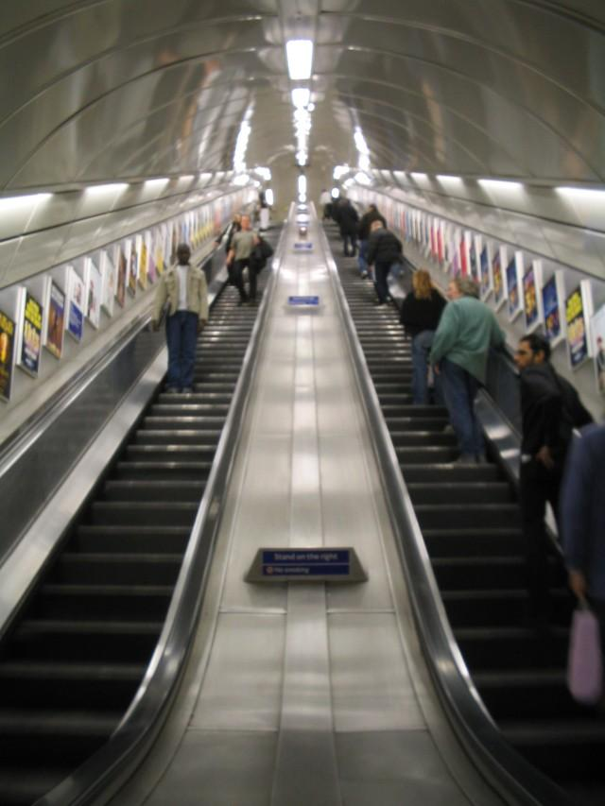
What is Velocity?
Velocity is a measure of the speed of an object AND the direction it is moving in space.
On the escalator, passengers are moving at the same constant speed, but they are moving in different directions.
Velocity can change even if speed is remaining constant (you just change direction)

Slide 45
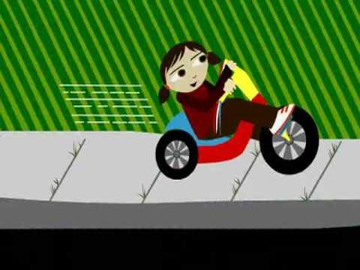
Speed is......._____________________________
Velocity is .... _____________________________

Slide 46

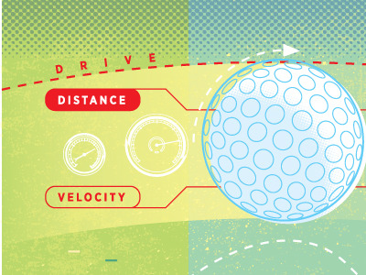
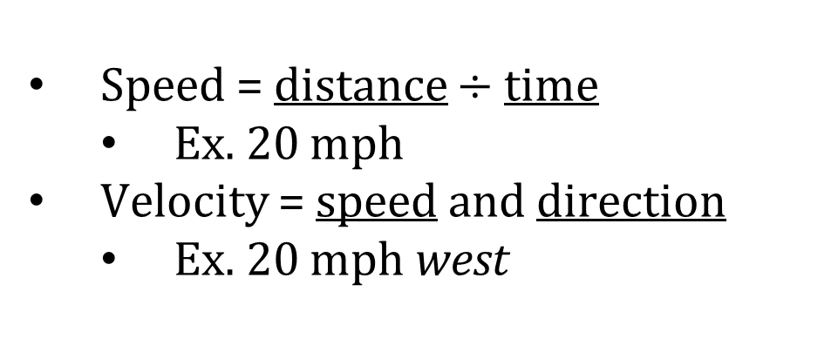
Speed vs. Velocity
Speed = distance $÷$time
  Ex. 20 mph
Velocity = speed and direction
  Ex. 20 mph west
What’s the difference between speed and velocity?

Slide 47
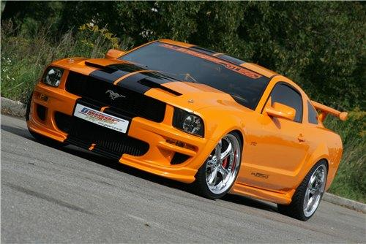
A car travels a distance of 500 m in 10 sec. What is the car's speed?
A second car travels a distance of 100 meters in 20 seconds. What is this car's speed?
s = d/t

Slide 48
Speed or Velocity?
What’s the difference?
13 m/s
65 mph west
3 ft/min south
16 in/s

Slide 49
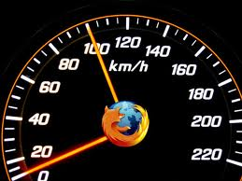

Terms for speed/velocity
Acceleration – to increase in speed.
What do you think this would look like on a graph?

Slide 50
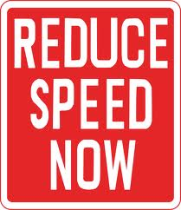
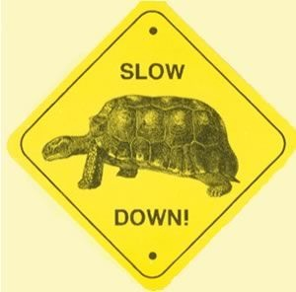
Terms for speed/velocity
Deceleration – to decrease in speed.
What do you think this would look like on a graph?

Slide 51
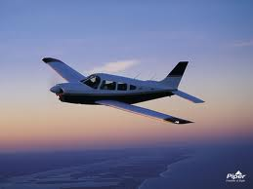
Terms for speed/velocity
Constant– speed stays the same.
What do you think this would look like on a graph?

Slide 52
Speed vs. Velocity
Acceleration: to increase in speed.
Deceleration: to decrease in speed.
Constant Velocity: speed stays the same.
  Forces are balanced.
Which line shows the object with balanced forces acting on it?
Velocity
Constant speed
Deceleration
Acceleration
Time

Slide 53
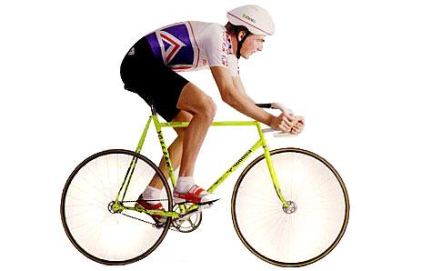
Constant Speed vs Changing Speed
Constant speed means that the speed stays the same throughout the entire distance
*Very few things can stay at a constant speed. Rather, things usually move at a constant speed for a period of time.
The cyclist speeds up, slows down, stops..etc

Slide 54
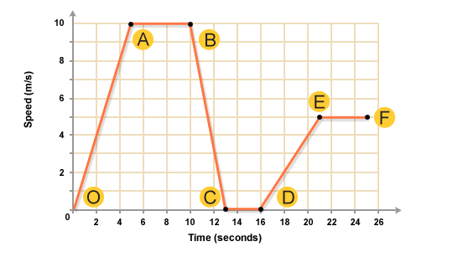
Graphs represent speeds of objects. This graph shows a bus as it travels its route.
Between what points is the bus accelerating? _____ & ____
Between what points is the bus moving at a constant speed?
_____ & _____
Between what points is the bus stopped? __________
Between what points it the bus decelerating? _________

Slide 55

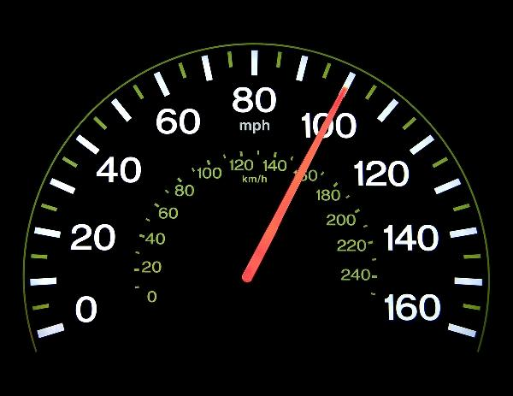
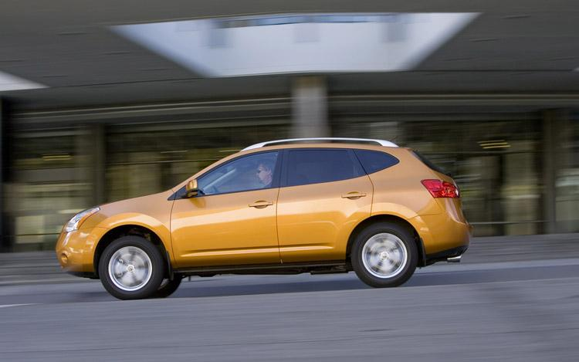
Change in velocity is often written as
the triangle indicates "change"
acceleration = change in velocity
change in time
If a car moves at a constant velocity, then its acceleration is zero

Slide 56
Acceleration = the rate of change of velocity
Positive acceleration = speeding up
Negative acceleration = slowing down
Change in Velocity = final velocity (v_{f}) - initial velocity (v_{i})
acceleration (m/s²) = (v_{f}) - (v_{i}) time

Slide 57
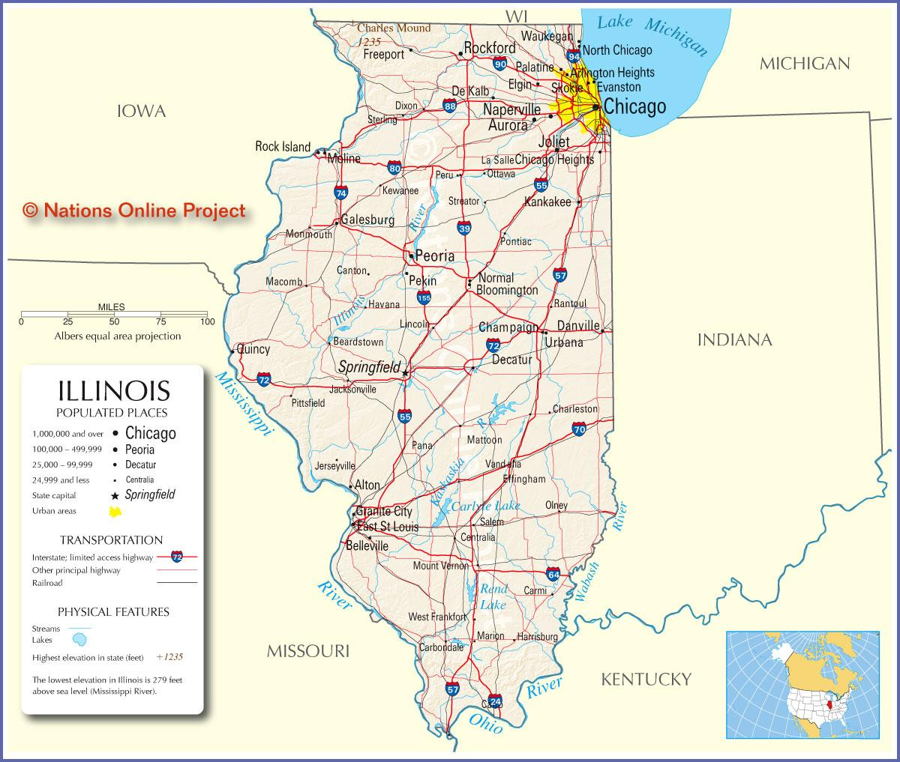
Average Speed = total distance traveled
time taken
This is useful when you are trying to measure speed, and the object moved at varying speeds throughout the trip. For instance, if you drove from here to Chicago, you might AVERAGE 60mph, even though you stopped at lights, or slowed down or when 70 at some points on your trip.

Slide 58

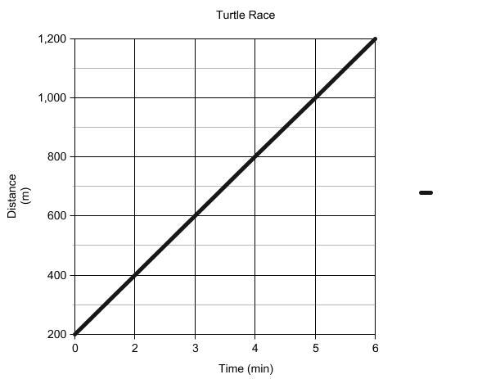
On graphs that show distance and time, the SLOPE of the line is a measure of the speed of an object.

Slide 59
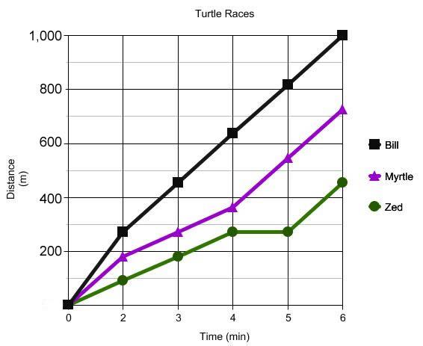
1. Calculate each turtle's speed:
Bill ______
Myrtle ______
Zed ______

Slide 60
2. Can you find from the graph, the point where Zed stopped and floated for a while?
3. Which turtle wins the race?
4. At what time period was Bill and Myrtle's speed the same?

Slide 61
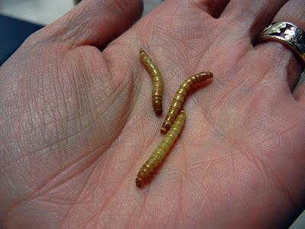
How can you measure the speed of a mealworm?

Slide 62

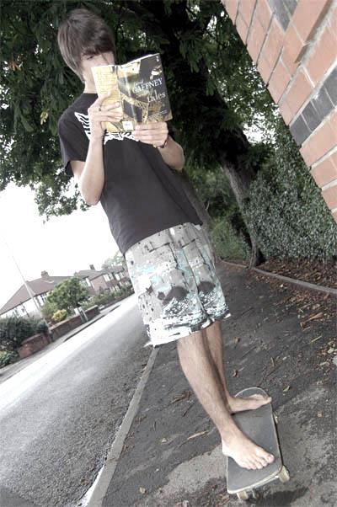
Calculations
A skateboarder is traveling at 8 m/s. He slows and comes to a stop in 4 sec. What was the acceleration? (hint: it is a negative number)
What is the Vf? _____
What is the Vi? _____

Slide 63
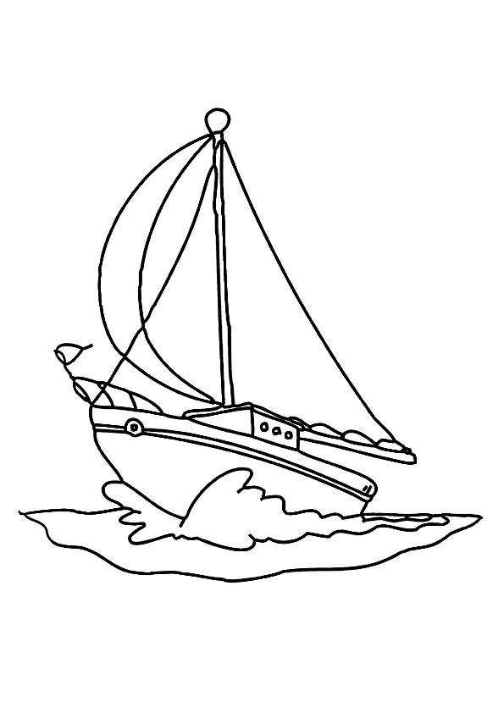
A sailboat is moving at 12 m/s when a gust of wind changes its velocity to 18 m/s. The wind lasts 10 seconds. For that 10 sec, what was its acceleration?
What is the Vf? _______
What is the Vi? _______
What is the t? _______

Slide 64
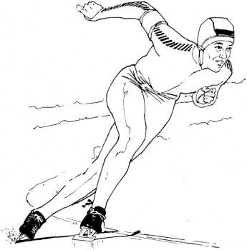
Think about this....
What are three ways to change the velocity of a car?
Accelerate
Decelerate
Change direction

Slide 65


Velocity = distance/time
1. If a person is walking at 4 m/s, how far can he travel in 30 seconds?
a) 120 meters b) 7.8 meters c) .08 meters
2. A spaceship can move 100 meters in 2 seconds. What is the ship's velocity?
a) 200 m/s b) 50 m/s c) .002 m/s
3. A chicken runs across the street at a speed of 12 m/s. If the road is 36 meters across, how long does it take for the chicken to cross the road?
a) 3 s b) 432 s c) .333 s

Slide 66

QUIZ TIME - MOTION

Slide 67
1. Motion indicates a change in _____________
2. Motion is relative to a ______________________
3. Acceleration is a change in ____________
4. Speed = distance / ?
5. Velocity is a measure of an object's speed and its
__________________________

Slide 68
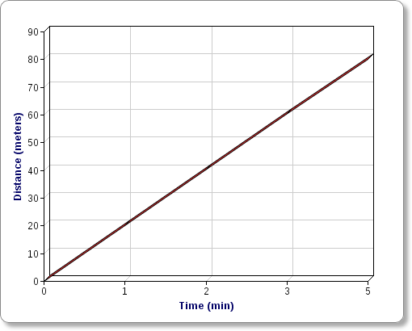
6. The slope of the line on the graph will tell you the object's ______________________. Hint: You calculated this for the turtle races.
7. The triangle in the equation represents ________
8. If you are slowing down, then you have a ____________
acceleration.

Slide 69
EQUATION: VELOCITY = distance / time
9. A boat moves 100 meters in 25 seconds. What is the boat's velocity.
SHOW YOUR WORK by writing the equation with the numbers plugged in. (1pt)
Find the correct answer (1 pt)

