Slide 1
Do Now: 3/31 1. Share a half sheet of paper with your neighbor 2. Write your name at the top 3. Number 1-5
Homework
None
Objective
I can describe Motion using a reference point I can calculate speed
Agenda
King or Queen Motion Lab

Slide 2
King or Queen

Slide 3
It took 3.5 hours for a train to travel the distance between two cities at a speed of 120 miles/hr. How many miles lie between the two cities?

Slide 4
How long would it take for a car to travel a distance of 200 kilometers if it is traveling at a speed of 55 km/hr? ________________

Slide 5
What is the speed of a car that traveled a total of 75 kilometers north in 1.5 hours?

Slide 6
What is the speed of a plane that traveled 3,000 miles from New York to California in 5.0 hours?

Slide 7
What is a reference point?

Slide 8
King or Queen Answers

Slide 9
It took 3.5 hours for a train to travel the distance between two cities at a speed of 120 miles/hr. How many miles lie between the two cities?

Slide 10
420 Miles

Slide 11
How long would it take for a car to travel a distance of 200 kilometers if it is traveling at a speed of 55 km/hr? ________________

Slide 12
3.6 Hours

Slide 13
What is the speed of a car that traveled a total of 75 kilometers north in 1.5 hours?

Slide 14
50 km/hr

Slide 15
What is the speed of a plane that traveled 3,000 miles from New York to California in 5.0 hours?

Slide 16
600 mi/hr

Slide 17
What is a reference point?

Slide 18
What is a reference point?

Slide 19
*distance of an object from another *A reference point is a point that is considered stationary to which the object in motion can be related to. *Starting line

Slide 20
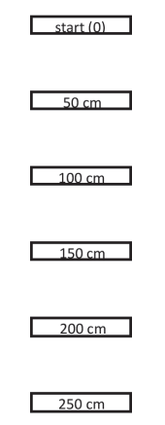
Let’s try it!
Team jobs: timer, starter
Create track: starting line and five lines (each 50 cm apart)
Position yourself.
Record /share data

Slide 21
Timers
Practice!!
Which button to start? Stop?
How do you reset?
What do you write down?

Slide 22
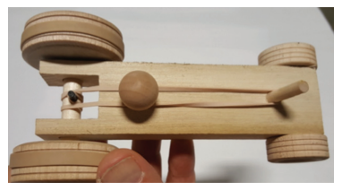
Careful with the car!!!
1. Rubber bands on the back wheels – for traction.
3. PEG on the front of the car…to hold the rubber band.
2. PEG on the back axle…to hold the rubber band.

Slide 23
Careful with the car!!!
Hold the car wheels steady and place the rubber band in position.
Use the back peg to count rotations as you “crank” up the rubber band.
Hook the rubber band on the back peg while its upright.

Slide 24
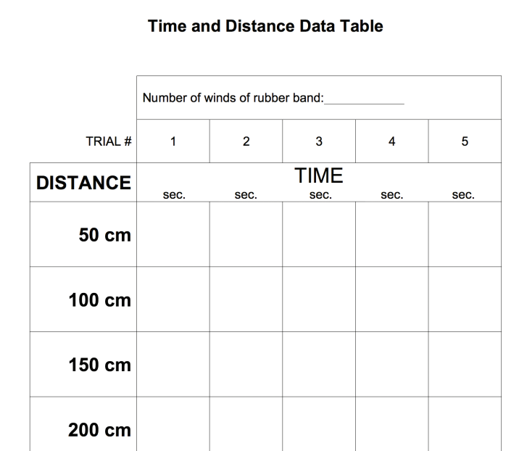
Four

Slide 25
Clean and sit!
Be sure the car is safely put away.
Thin rubber band to me. Wheel bands stay on the car.
Car returned to the “garage”
Timers cleared, returned.
You keep and finish your graph.

Slide 26
Mar. 30, 2017
You need:
Clean paper / pencil
Phil’s story (graph)
Warm Up:
Mental Math quiz…BE READY!!!
I CAN: collect data and organize it into a graph.
(I can illustrate the motion of an object!)

Slide 27
Conversion in the METRIC system…
NAME!
RIGHT
Kilo
km
Hecto
Deka
hm
dkm
deci
LEFT
centi
Meter
Liter
Gram
dm
milli
cm
mm

Slide 28
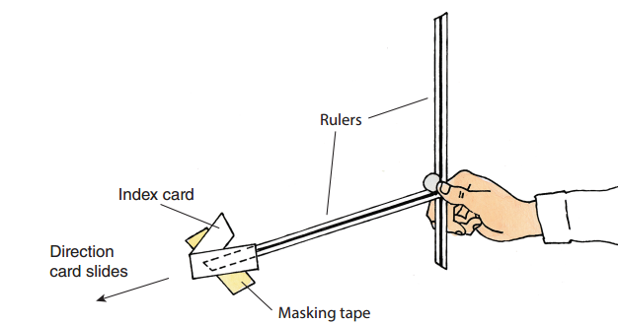
The binder clip will be set at 10 cm – so the ramp is at 10 cm.
An index card to indicate the movement.
Binder clip – to steady the ramp
To mark a place for the ramp AND a start for the index card.
End point – to be measured for distance.

Slide 29
Motion – Occurs when an object changes _____________ relative to a _____________ ____________.
position
reference
point

Slide 30
-Distance: how ________ an object has traveled.
-Displacement: ______________ and _____________ of an object’s change in position from the starting point.
far
distance
direction

Slide 31
Speed – the _________________ an object travels per unit of _________________. Also known as the ____________ of change in position.
distance
time
rate

Slide 32
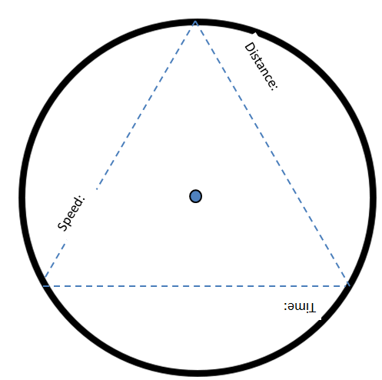
Speed =
d
Distance
Time
s
t

Slide 33
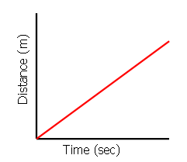
FAST vs. SLOW

Slide 34
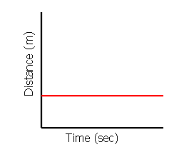
No Motion

Slide 35
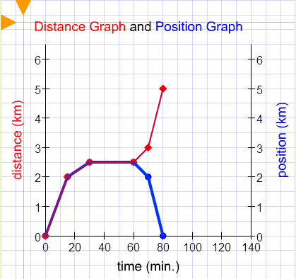
C
Leg 5
D
Leg 3
Leg 2
A
Leg 4
D
A
Leg 1

